Slide 1


Slide 2
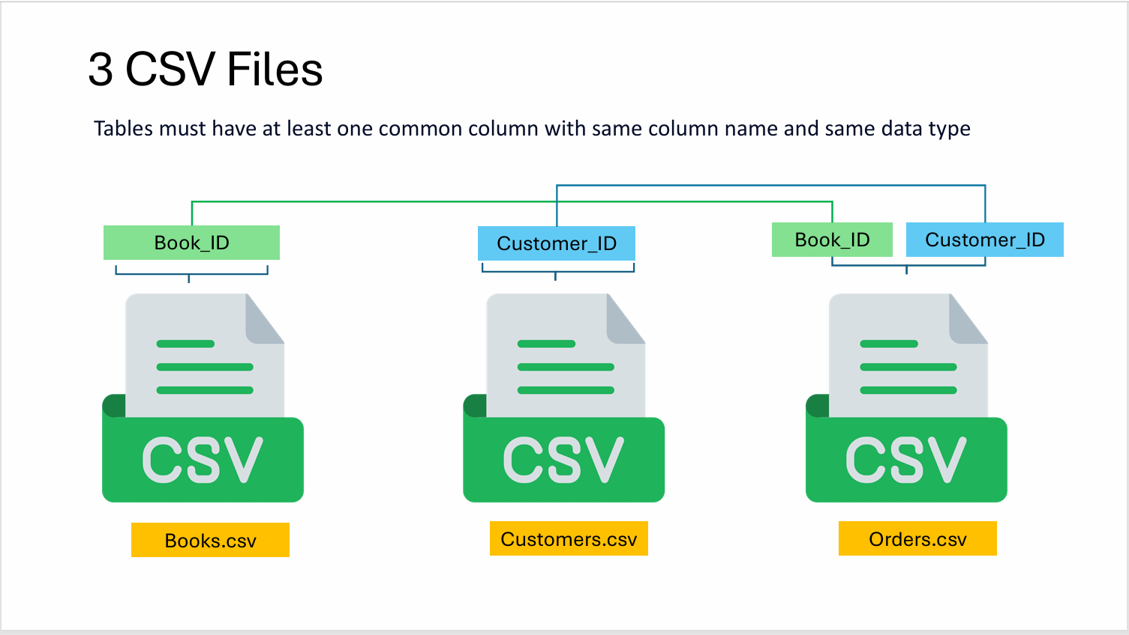

Slide 3
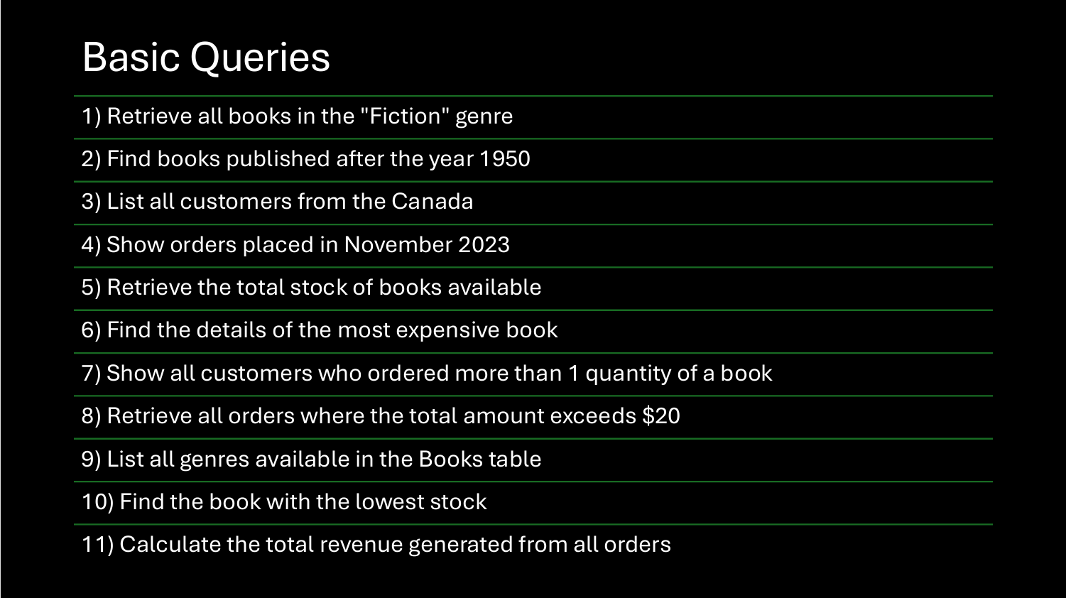

Slide 4
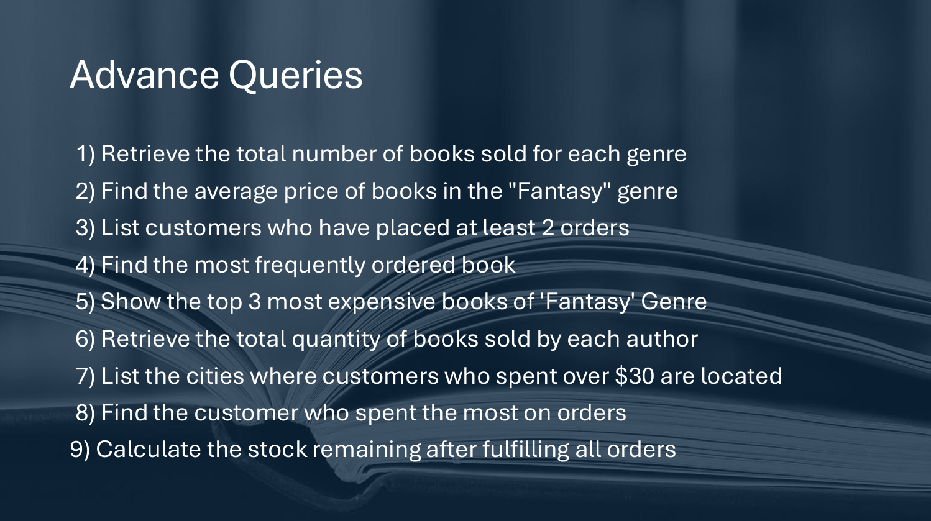

Slide 5
-- Basic Queries:
-- 1) Retrieve all books in the "Fiction" genre:
SELECT *
FROM books
WHERE genre = 'Fiction';
-- 2) Find books published after the year 1950:
SELECT *
FROM books
WHERE published_year > '1950';
-- 3) List all customers from the Canada:
SELECT *
FROM customers
WHERE country = 'Canada';
-- 4) Show orders placed in November 2023:
SELECT *
FROM Orders
WHERE Order_date BETWEEN '2023-11-01'
AND '2023-11-30';

Slide 6
-- 5) Retrieve the total stock of books available:
SELECT
SUM(stock) AS total_stock
FROM Books;
-- 6) Find the details of the most expensive book:
SELECT *
FROM Books
ORDER BY price DESC
LIMIT 1;
-- 7) Show all customers who ordered more than 1 quantity of a book:
SELECT *
FROM orders
WHERE quantity > 1;
-- 8) Retrieve all orders where the total amount exceeds $20:
SELECT *
FROM orders
WHERE total_amount > 20;

Slide 7
-- 9) List all genres available in the Books table:
SELECT
DISTINCT genre
FROM books;
-- 10) Find the book with the lowest stock:
SELECT *
FROM books
ORDER BY stock ASC
LIMIT 1;
-- 11) Calculate the total revenue generated from all orders:
SELECT
SUM(total_amount) AS revenue
FROM orders;

Slide 8
-- Advance Queries :
-- 1) Retrieve the total number of books sold for each genre:
SELECT b.genre,
SUM(o.quantity) AS total_book
FROM orders O
join books b
ON o.book_id = b.book_id
GROUP BY b.genre;
-- 2) Find the average price of books in the "Fantasy" genre:
SELECT
AVG(price) AS average_price
FROM books
WHERE genre = 'Fantasy'
GROUP BY genre;

Slide 9
-- 3) List customers who have placed at least 2 orders:
SELECT o.customer_id, c.name,
COUNT(o.order_id) AS order_count
FROM orders o
JOIN customers c
ON o.customer_id = c.customer_id
GROUP BY o.customer_id, c.name
HAVING COUNT(order_id) >= 2;
4) Find the most frequently ordered book:
SELECT o.book_id, b.title,
COUNT(o.order_id) AS order_count
FROM orderS o
JOIN books b
ON o.book_id = b.book_id
GROUP BY o.book_id, b.title
ORDER BY order_count DESC
LIMIT 1;

Slide 10
-- 5) Show the top 3 most expensive books of 'Fantasy' Genre:
SELECT *
FROM books
WHERE genre = 'Fantasy'
ORDER BY price DESC
LIMIT 3;
6) Retrieve the total quantity of books sold by each author:
SELECT b.author,
SUM(o.quantity) AS total_book_sold
FROM orders o
JOIN books b
ON b.book_id = o.book_id
GROUP BY b.author;
-- 7) List the cities where customers who spent over $30 are located:
SELECT
DISTINCT c.city, total_amount
FROM orders o
JOIN customers c
ON o.customer_id = c.customer_id
WHERE o.totaL_amount > 30;

Slide 11
8) Find the customer who spent the most on orders:
SELECT c.customer_id, c.name,
SUM(o.total_amount) AS total_spent
FROM orders o
JOIN customers c
ON o.customer_id = c.customer_id
GROUP BY c.customer_id, c.name
ORDER BY total_spent DESC
LIMIT 1;
--9) Calculate the stock remaining after fulfilling all orders:
SELECT b.book_id, b.title, b.stock,
COALESCE (SUM(o.quantity),0) AS order_quantity, b.stock - COALESCE (sum(o.quantity),0) AS remaining_quantity
FROM books b
LEFT JOIN orders o
ON b.book_id = o.book_id
GROUP BY b.book_id
ORDER BY b.book_id;

